Slide 1
Module 1: RNA-sequencing
Patrick Fiaux
01/08/2019

Slide 2
RNA-seq Pipeline
RNA Isolation and Fragmentation
Library Preparation
Sequencing
Genomic Alignment of Sequencing Reads
Notes:
EST: expressed sequence tag

Slide 3
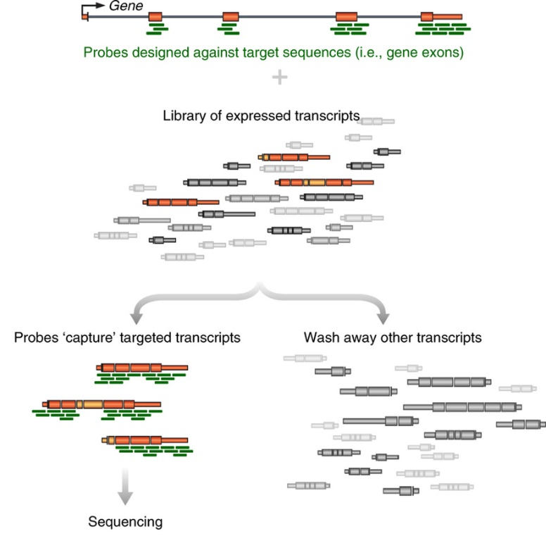
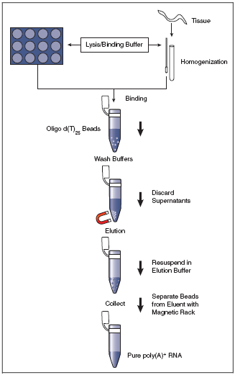
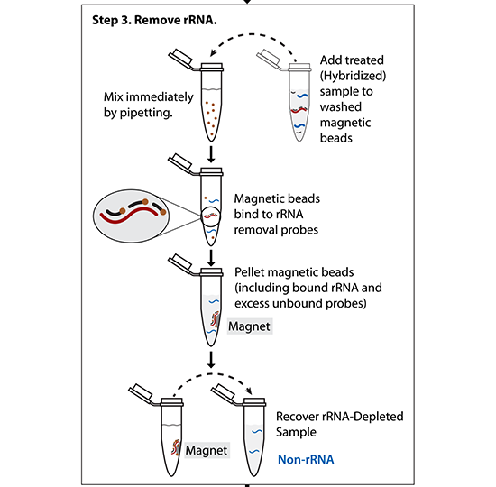
RNA Isolation: Choosing RNA extraction
mRNA only -> PolyA selection
rRNA-depleted RNAs -> rRNA negative selection
Specific RNAs -> targeted enrichment
(All mRNAs are polyadenylated at the 3’ end – can use d(T)₂₅ beads to select)
(Probes matching rRNA are used to pull-out rRNA molecules)
(Other methods – hybridize targeted DNA oligos + RNAseH treat)

Slide 4
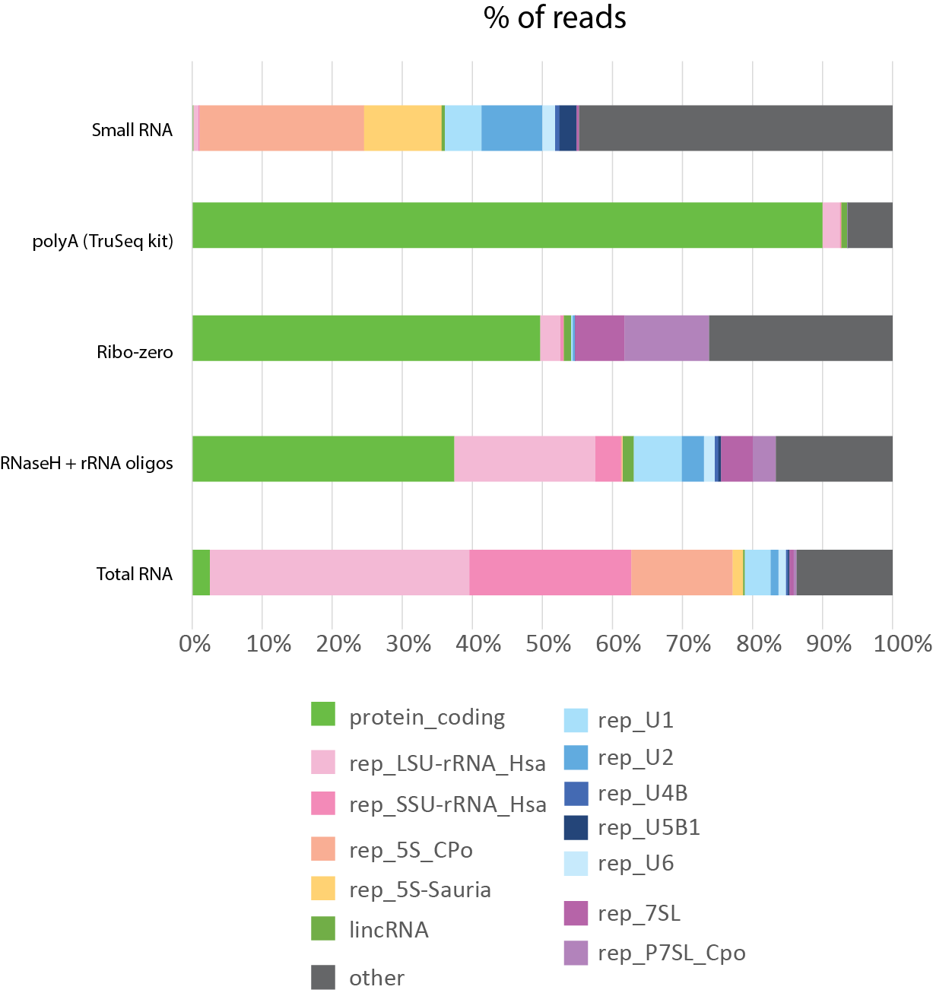
RNA Isolation: Types of RNA extracted
Preparation method greatly impacts the over profile of your library
Notes:
LSU: large subunit ribosomal RNA

Slide 5
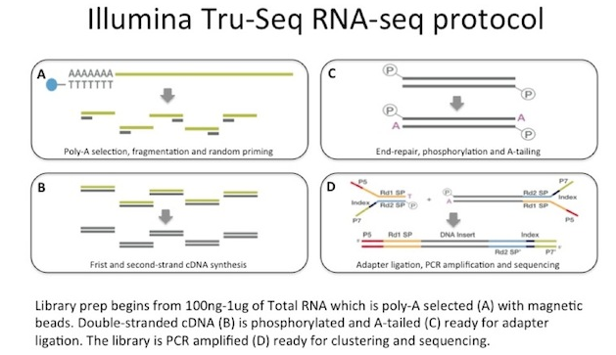
Library Preparation

Slide 6
Strand Information: why to retain it
Accurately identifies antisense transcripts
Determines transcribed strand of non-coding RNA (e.g. lincRNAs)
Demarcates boundaries of closely situated genes
Illumina RNA ligation method
dUTP method

Slide 7
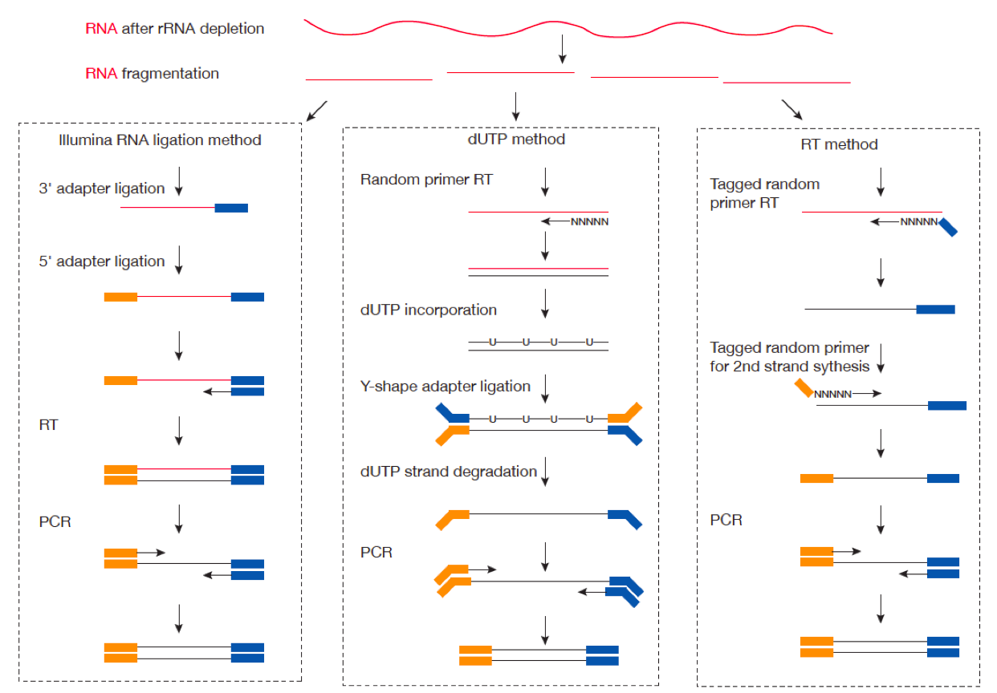
Strand Information: how to retain it

Slide 8
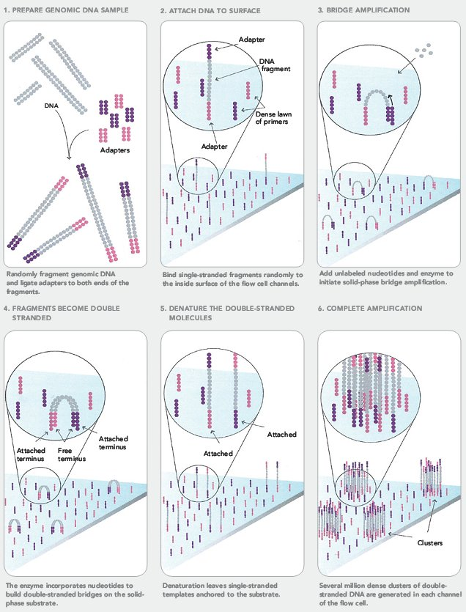
Sequencing on Illumina Flowcell
https://www.youtube.com/watch?v=fCd6B5HRaZ8

Slide 9
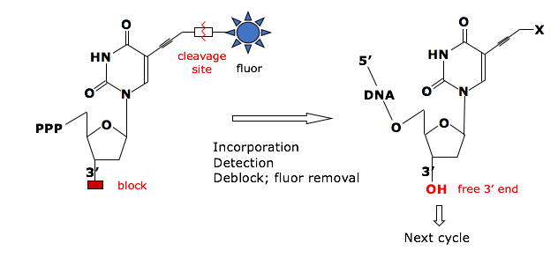
Sequencing by Synthesis
Reversible Terminator Chemistry
3’-
…-5’
5’-
G
T
A
T
T
T
T
C
G
G
C
A
C
A
G
A
G
A
C
T
T
C
T
G
Cycle 1: Add sequencing reagents
First base incorporated
Remove unincorporated bases
Detect signal
Cycle 2-n: Add sequencing reagents and repeat

Slide 10
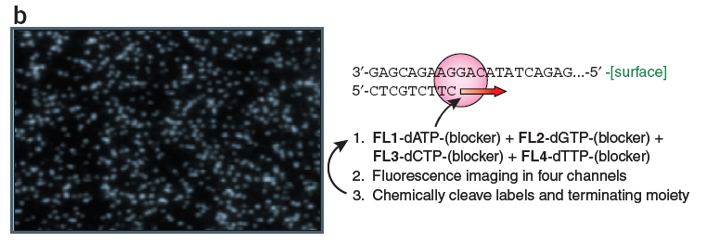
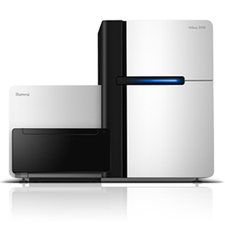
Sequencing by synthesis: HiSeq 2500 (Illumina)
Shendure & Lee, Nat. Biotech. 2008
Can do 50bp to 250bp single-end or paired-end reads
~300 million reads per lane x (2 or 8) lanes
4-8 days run time
200 billion bp output each run
Notes:
10

Slide 11
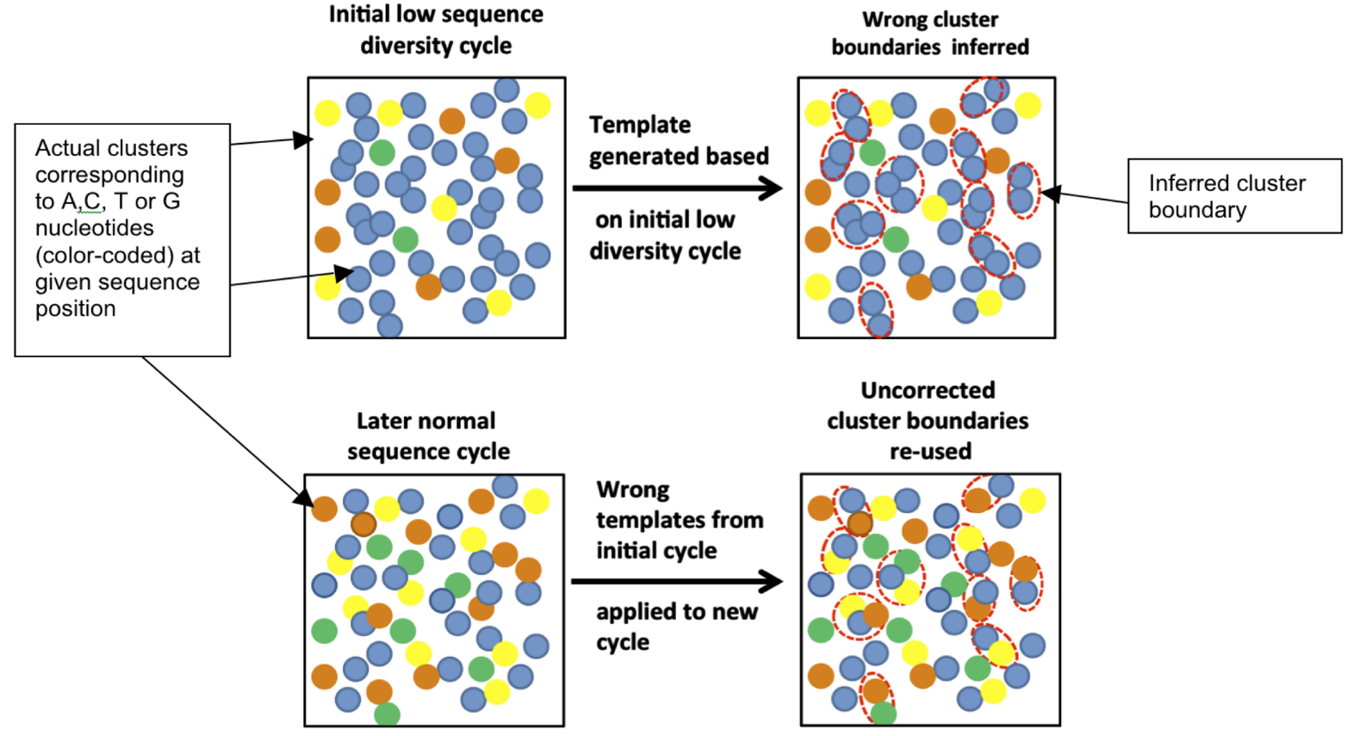
Key considerations
“Cluster Density” = how many clusters are there per mm²
If too high, hard to properly draw cluster boundaries
“Library Complexity” = how diverse are the sequences?
Illumina identifies clusters in the first 5 cycles – if those 5 cycles are identical for nearby clusters, the software doesn’t know to split them into two
Mitra, A. et al. Plos ONE (2015)
Notes:
How can you solve a problem like this?
Decrease cluster density – works, but lose sequencing power
Artificially add complexity
Spike in other libraries
Add random-mers

Slide 12
Illumina sequencing – fragment strategy
I5 adapter
Read1 primer
DNA insert (your library)
Read2* primer
I7 adapter
Flow Cell Surface
I5 index*
I7 index*
* optional
Reaction #
Flow Cell Surface
1
Read1 primer
Read1 sequence
Flow Cell Surface
2*
Index1 primer
Index1 sequence

Slide 13
Illumina sequencing – Paired End & Dual Indexing
Reaction #
Flow Cell Surface
1
Read1 primer
Read1 sequence
Flow Cell Surface
2*
Index1 primer
Index1
(I7) sequence
Flow Cell Surface
3*
Index2 primer
Index2
(I5) sequence
Flow Cell Surface
4*
Read2 primer
Read2
sequence
* optional

Slide 14
Paired-end sequencing results in more accurate sequence alignment

Slide 15
RNA-Seq Analysis Overview:
Download Data
(fastq)
Check Quality (fastqc)
Align to Genome (STAR)
Sort and Index BAM (samtools)
Count Reads Mapped to Genes (featureCounts)
Differential Expression (DESeq2)
Interesting Biology!

Slide 16

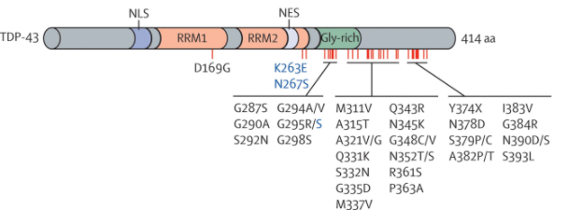
Experiment: TARDBP shRNA from ENCODE
TARDBP/TDP-43:
DNA and RNA-binding protein regulating transcription and alternative splicing
Aberrantly processed forms of TARDP miseggregate to cytoplasm and re associated with neurodegenerative diseases (FTLD, ALS)
Dataset: What are the transcriptional consequences of TARDBP depletion?
https://www.encodeproject.org/rna-seq/long-rnas/
Each replicate should have 30 million aligned reads, although older projects aimed for 20 million reads.
Replicate concordance: the gene level quantification should have a Spearman correlation of >0.9 between isogenic replicates and >0.8 between anisogenic replicates (i.e. replicates from different donors).
Notes:
The Encyclopedia of DNA Elements (ENCODE) is a public research project launched by the US National Human Genome Research Institute (NHGRI) in September 2003. Intended as a follow-up to the Human Genome Project (Genomic Research), the ENCODE project aims to identify all functional elements in the human genome.

Slide 17
Fastq File
First line is the information about the location of the read and specific sequencing machine used:
Second line is the nucleotide sequence called
Third line is “+” and can optionally be followed by a repeat of the filename in line 1
Fourth line contains the quality score as determined by the sequencer
@NS500672:54:HL775BGXX:1:11101:22716:1042 1:N:0:CCCCGG
CCGCCNATGCCCATGCCACAGTTGTTGAGCTTGAGTTCCTGCAGGGTGAAGCAGGCTGAGCTCTTGAGCAGGGCCTCGAA
+
AAAAA#EEEEEEEEEEEEEEEEEEEEEEEEEEEEEEEEEEEEEEEEEEEEEEEEEAEEEEEEEEEEEEEEEEEEEEEEEE
Notes:
Four lines represent 1 read off the machine

Slide 18
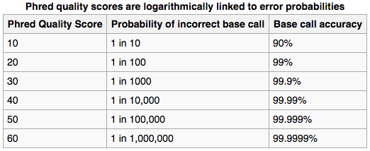
Fastq File – Phred Quality Score
Quality scores report the probability that the base call is incorrect
Field standard is to accept bases with quality >20
Notes:
Four lines represent 1 read off the machine
Quality scores have been converted into the ascii code for reporting… not important here

Slide 19
Illumina sequencing – great for read #, not great for read length
Quality score
0
100
200
300
400
Cycle #

Slide 20
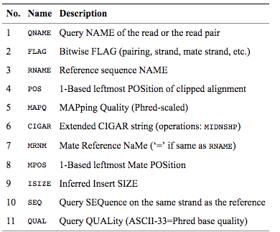
SAM/BAM File
BAM files are binary, you must use samtools to view them
Bioinformatics. 2009 Aug 15;25(16):2078-9. Epub 2009 Jun 8. The Sequence Alignment/Map format and SAMtools.
Notes:
Four lines represent 1 read off the machine

Slide 21
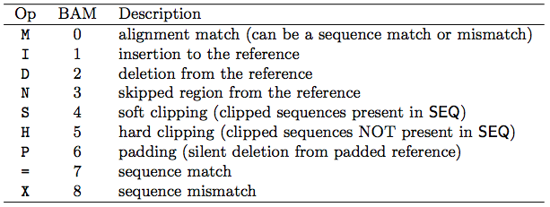
Concise Idiosyncratic Gapped Alignment Report (CIGAR) String
Contains specific information about the mapping information at specific positions across the read
Bioinformatics. 2009 Aug 15;25(16):2078-9. Epub 2009 Jun 8. The Sequence Alignment/Map format and SAMtools.

